Slide 1

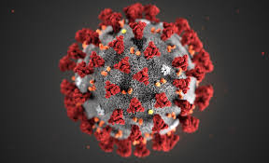
Top 3 Virus Slide Shows

Slide 2
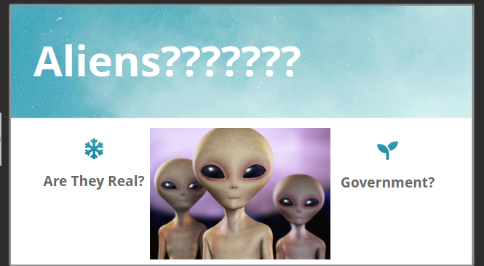
Number 3: Sky

Slide 3
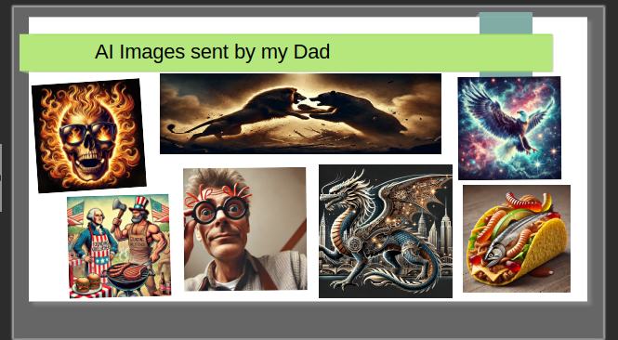
Number 2: AI Images from Dad

Slide 4
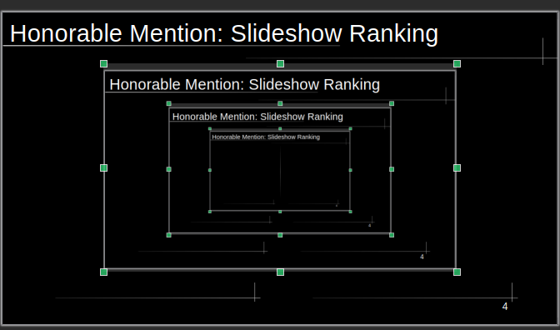
Honorable Mention: Slideshow Ranking

Slide 5
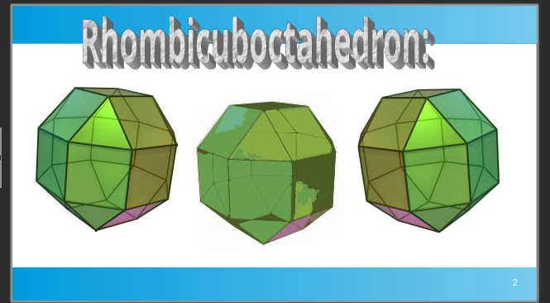
Number 1: Shapes

